Slide 2
Lets Play a game:
The challenge (if you choose to accept it) is to organize all the people in the room in chronological order by date of birth (excluding year). Without speaking.
January 1 should stand nearest the screen and December 31 should stand on the other side of the room, find where you belong between these two dates.
Once we are in order- Kim will hand you an envelope with a date on it, it should be relatively close to your birthdate and she will explain how today’s forum will unfold.

Slide 3
These people continued in the apostles’ teaching, fellowship, the breaking of bread and the prayers
Join in celebrating the saints of the past century- In each envelope you will find the collect for a saint who we celebrate near your birthday. When we get to the date on your envelope read the collect aloud.
After the collect is read we will take a moment to talk about the saint or saints.

Slide 4
January Saints

Slide 5
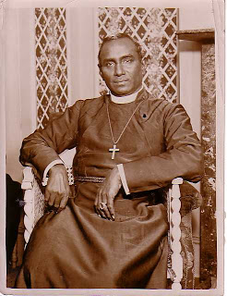
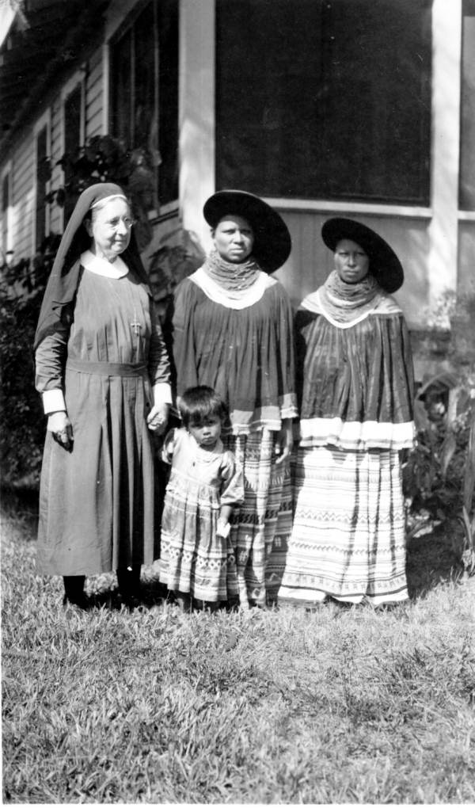
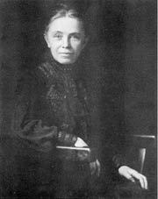
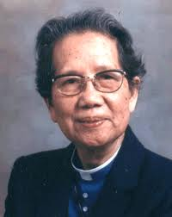
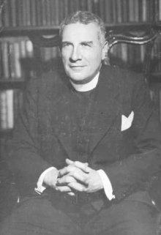
Jan. 2 Vedanayagam Samuel Azariah (1945) - Bishop
Jan. 8 Harriet Bedell (1969)- Deaconess
Jan. 9 Julia Chester Emery (1922)- Upholder of Missions
Jan. 24 Florence Li Tim Oi (1944) - First Female Ordained Priest
Jan. 31 Samuel Shoemaker (1963) Priest Cofounder of A.A.

Slide 6
February Saints

Slide 7
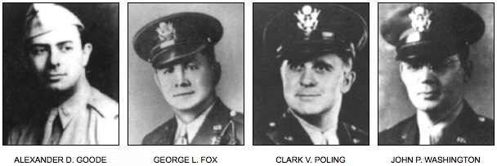
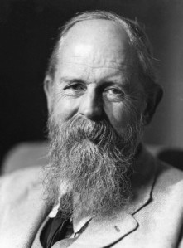
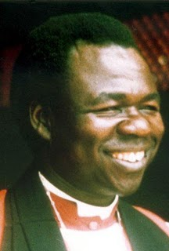
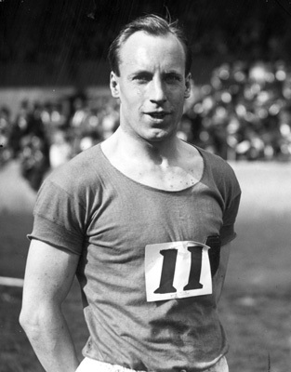
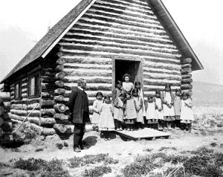
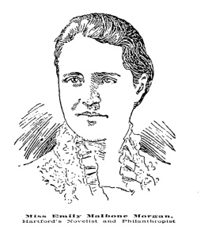
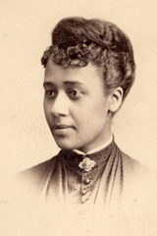
Feb. 3 Dorchester Chaplains (1943) Military Chaplains
Feb. 12 Charles Freer Andrews (1940) Priest and Friend of Gandhi
Feb. 17 Janani Luwum (1977) Archbishop of Uganda and Martyr
Feb. 22 Eric Liddell (1945) Olympian Priest and Martyr
Feb. 25 John Roberts (1949) Priest and Missionary
Feb. 26 Emily Malbone Morgan (1937) Laywoman Social Justice Reformer
Feb. 28 Anna Julia Cooper (1964) Educator

Slide 8
March
Saints

Slide 9
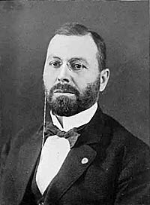
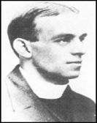
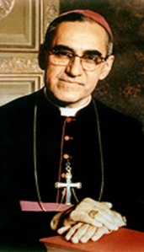
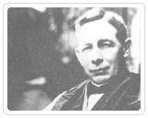
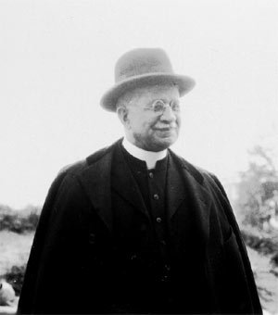
Mar. 6 Charles Menninger (1953) Doctor
Mar. 8 Geoffrey Anketell Studdert Kennedy (1929) Priest Chaplain WWI
Mar. 24 Oscar Romero (1980) Priest and Martyr
Mar. 27 Charles Henry Brent (1929) Bishop of the Phillipines and Western New York
Mar. 28 James Solomon Russell (1935) Former Slave Priest

Slide 10
April
Saints

Slide 11
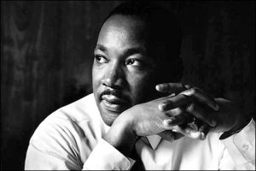
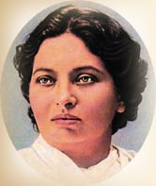
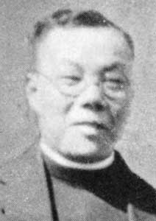
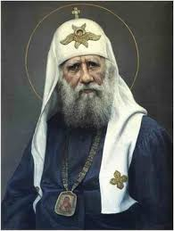
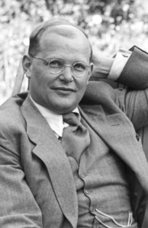
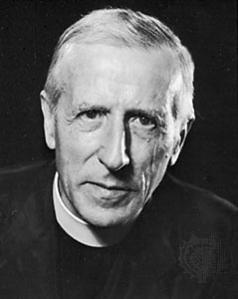
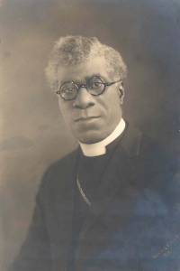
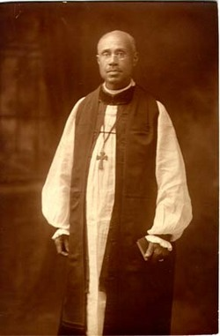
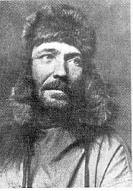
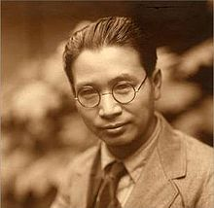
April 4 Martin Luther King Jr (1968) Civil Rights Leader and Martyr
April 5 Pandita Mary Ramabai (1922) Prophetic Witness Evangelist India
April 6 Daniel GC Wu (1956) Priest and Missionary Chinese Americans
April 7 Tikhon Patriarch of Russia (1925) Confessor and Ecumenist
April 9 Dietrich Bonhoeffer (1945) Theologian and Martyr
April 10 Pierre Teilhard de Chardin (1955) Scientist and Military Chaplain
April 14 Edward Thomas Demby (1957) Henry Beard Delany (1928) First African American Bishops in TEC
April 22 Hudson Stuck (1920) Priest and Environmentalist
April 23 Toyohiko Kagawa (1960) Prophetic Witness to Japan

Slide 12
May
Saints

Slide 13
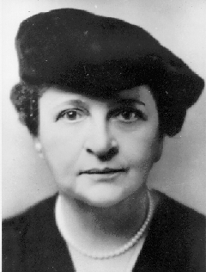
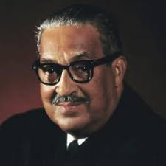
May 13 Frances Perkins (1965) Public Servant Prophetic Witness
May 17 Thurgood Marshall (1993) Lawyer and Jurist

Slide 14
June
Saints

Slide 15
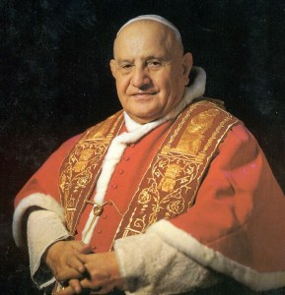
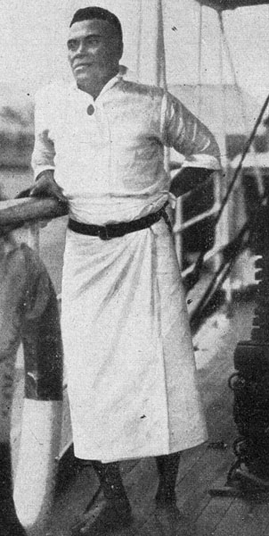
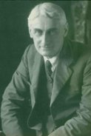
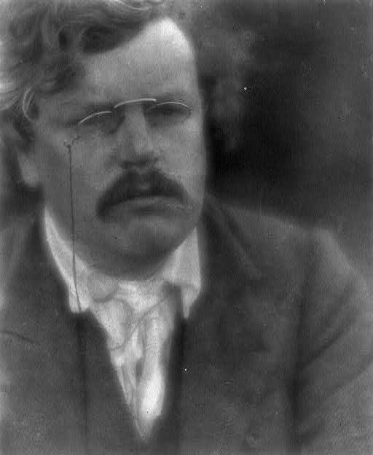
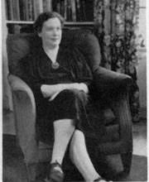
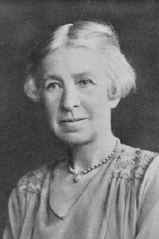
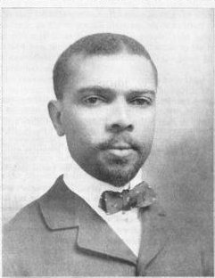
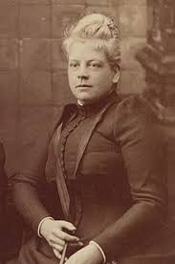
June 4 John XXIII (1963) Angelo Guiseppe Roncalli Bishop of Rome- Pope
June 6 Ini Kopuria (1945) Founder of the Melanesian Brotherhood
June 8 Roland Allen (1947) Mission Strategist
June 13 Gilbert Keith Chesterton (1963) Apologist and Writer
June 15 Evelyn Underhill (1941) Author and Mystic
June 19 Adelaide Teague Case (1948) Teacher
June 25 James Weldon Johnson (1938) Poet
June 26 Isabel Florence Hapgood (1929) Translator, Ecumenist and Journalist

Slide 16
July
Saints

Slide 17
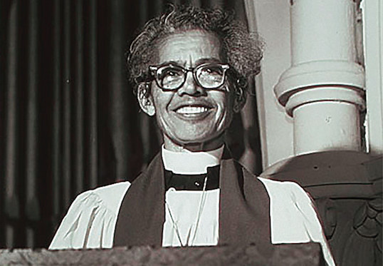
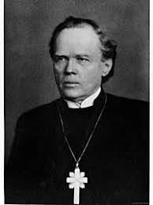
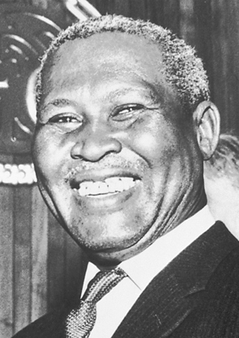
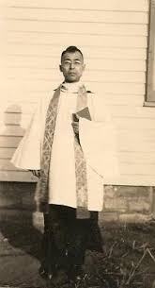
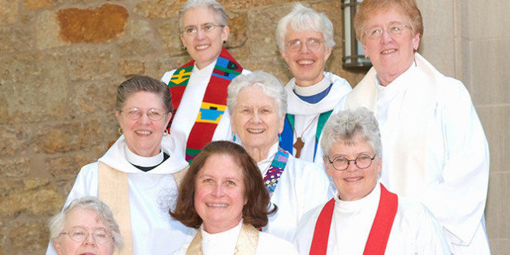
July 1 Pauli Murray (1985) Female African American Priest
July 12 Nathan Soderblom (1931) Archbishop of Uppsala and Ecumenist
July 21 Albert John Luthuli (1967) Prophetic Witness South Africa
July 26 Charles Raymond Barnes (1938) Priest and Martyr Dominican Republic
July 29 Philadelphia 11 (1974) The First Female Ordination to the Priesthood

Slide 18
August
Saints

Slide 19
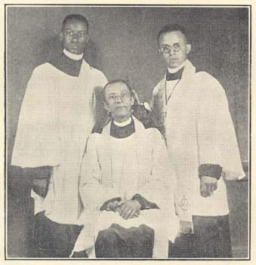
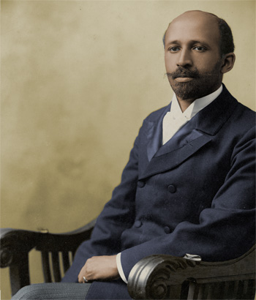
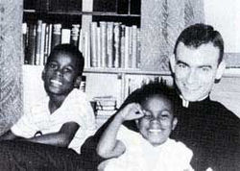
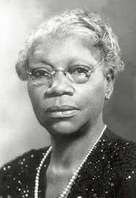
Aug. 3 George Freeman Bragg Jr (1940) Priest African American Social Justice
Aug. 3 William Edward Burghard Du Bois (1963) Sociologist
Aug. 14 Jonathan Myrick Daniels (1965) Seminarian Martyr
Aug. 16 Artemisia Bowden(1969) Teacher Social Justice Prophetic Voice

Slide 20
September
Saints

Slide 21
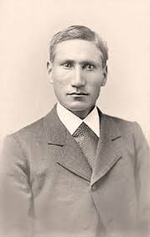
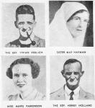
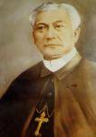
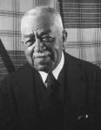
Sept. 1 David Pendleton Oakerhater (1931) Deacon and Missionary
Sept. 2 Martyrs of New Guinea (1942)
Sept. 4 Paul Jones (1941) Bishop of Utah and Conscientious Objector
Sept. 4 Albert Schweitzer (1965) Musician, theologian, doctor, humanitarian
Sept. 5 Gregorio Aglipay (1940) Priest Founder of Philippine Independent Church
Sept. 11 Harry Thacker Burleigh (1949) Composer
Sept. 18 Dag Hjalmar Agne Carl Jammarskjold (1961) Diplomat Economist and Author
Sept. 24 Anna Ellison Buttler Alexander (1947)First African American Deaconess teacher and minister
Sept. 26 Wilson Carlile (1942) Priest

Slide 22
October
Saints

Slide 23
Oct. 3 John Raleigh Mott (1955) Evangelist and Ecumenical Pioneer
Oct. 8 William Dwight Porter Bliss (1926) and Richard Theodore Ely (1943) Priest and Economist
Oct. 9 Wilfred Thomason Grenfell (1940) Medical Missionary
Oct. 10 Vida Dutton Scudder (1954) Educator and Witness for Peace
Oct. 24 Hiram Hisanori Kano (1986) Saint of Nebraska and Colorado - Japanese American missionary
Oct. 31 Paul Shinji Sasaki (1946) Bishop of Mid Japan and Tokyo; Philip Lindel Tsen (1954) Bishop of Honan China

Slide 24
November
Saints

Slide 25
Nov. 6 William Temple (1944) Archbishop of Canterbury
Nov. 22 Clive Staples Lewis (1963) Apologist and Spiritual Writer
Nov. 25 James Otis Sargent Huntington (1935) priest and Monk

Slide 26
December
Saints

Slide 27
Dec. 10 Karl Barth (1968) Pastor and Theologian
Dec. 10 Thomas Merton (1968) Contemplative and Writer
Dec. 16 Ralph Adams Gram (1942) Architect
Dec. 19 Lillian Trasher (1961) Missionary in Egypt
Dec. 30 Frances Joseph Gaudet (1934) Educator and Prison Reform

Slide 28
How many of the saints we prayed about today did you know?
Interested in learning more about the lives and ministries of these saintly examples?
One Place to Start is the book The Great Cloud of Witnesses

